Slide 1
Seminar 1: Software Architecture
Naida Demirovic Group 6

Slide 2
Summary
Solution
Class diagram
Uses structure
Task II
Modifiability

Slide 3
Solution
The KWIC (Key Word in Context) index system accepts an ordered set of lines, each line is an ordered set of words, and each word is an ordered set of characters. Any line may be “circularly shifted” by repeatedly removing the first word and appending it at the end of the line. The KWIC index system outputs a listing of all circular shifts of all lines in alphabetical order. [David Parnas]
Input->Characters->CircularShifter->Alphabetizer->Output->Program
-in the main program function each of those classes calls the previous one
-they are all connected

Slide 4
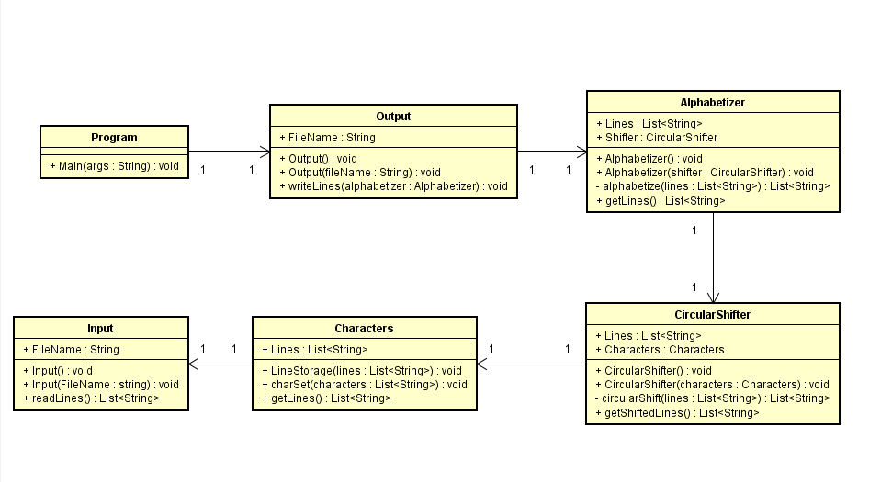
Class diagram

Slide 5
Uses structure
-the program wouldn’t run without one of the classes
Input
Characters
CircularShifter<-Characters
Alphabetizer<-CircularShifer<-Characters
Output<-Alphabetizer<-CircularShifer<-Characters
Program<-Output<-Alphabetizer<-CircularShifer<-Characters<-Input

Slide 6
Task II
Description: the system that only reads in one line and outputs all circular shifts of that line in any order
Solution:
-Alphabetizer class is not needed
-change circularShift method in CircularShifter class
-CircularShifter object instead of Alphabetizer object in Output class
-no need to go through each line -> get access to the text file and fill it with shifted words

Slide 7
Modifiability
Reduce size of module
Reduce coupling
Defer binding

